Slide 1
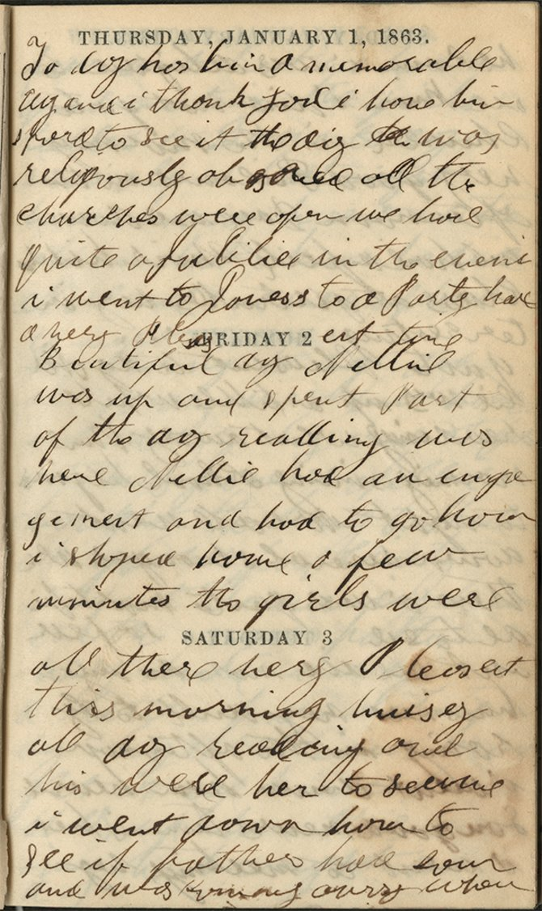

Emilie Davis
Lesson Plan
Emilie Davis’s diary, her attendance at a Black Swan show in Philadelphia, and my desire to teach more about regular Black folk led to the lesson I created on Emilie Davis.

Slide 2

Do Now
Option 1: Think Write Share
Do you keep a journal? If so, which of these do you write about the most? Why?
weather
your job
your beliefs
your social life
your family
local/national news
something else
If you do not keep a journal, which one do you think people write about the most? Why?

Slide 3
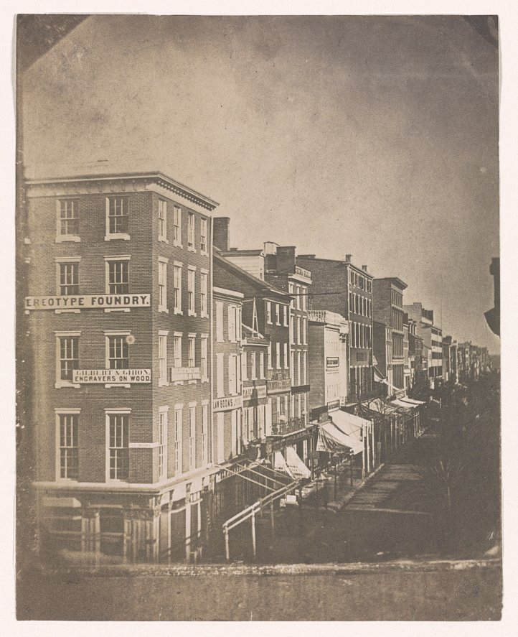
Option 2: Think Write Share
What do you think life was like in Philadelphia in 1862 for Black women during the Civil War?

Slide 4
Essential Question
How did Emilie Davis’s Black agency help support the abolitionist movement?

Slide 5
Black Agency:
Any effort to promote Black liberation and individual power

Slide 6
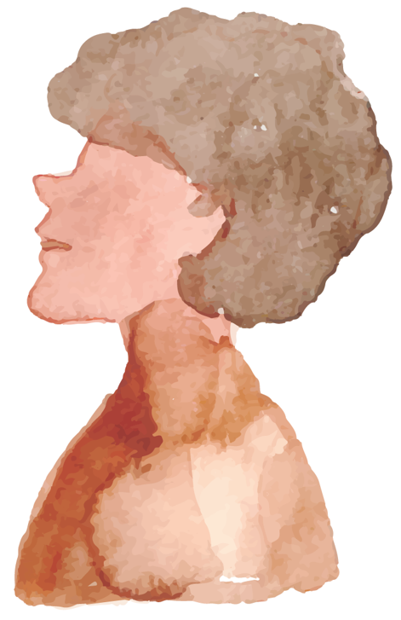
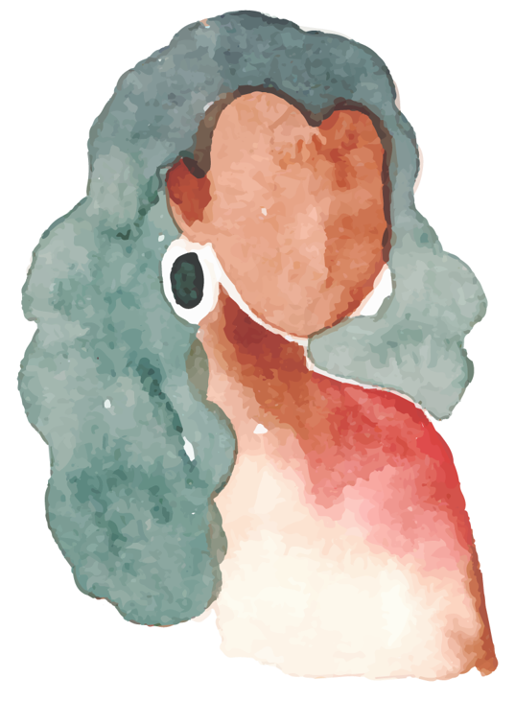
Who was Emilie Davis?

Slide 7
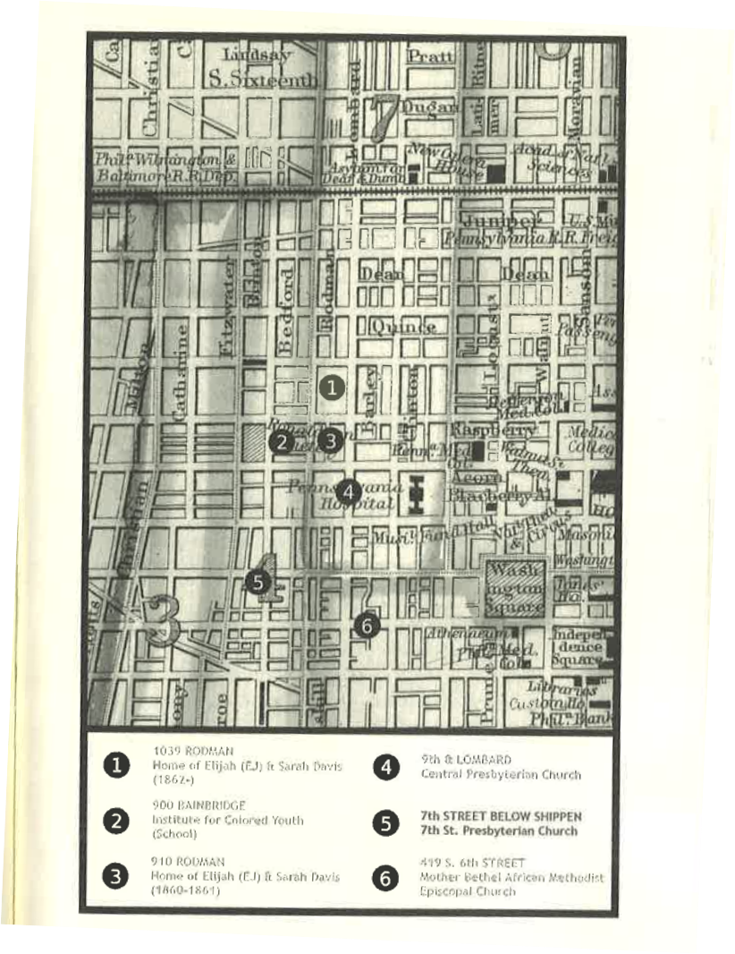
Look at this map.
What are some specific locations that Emilie Davis likely engaged with or attended?
What do you think she did at these locations?
Who did she likely talk to?

Slide 8
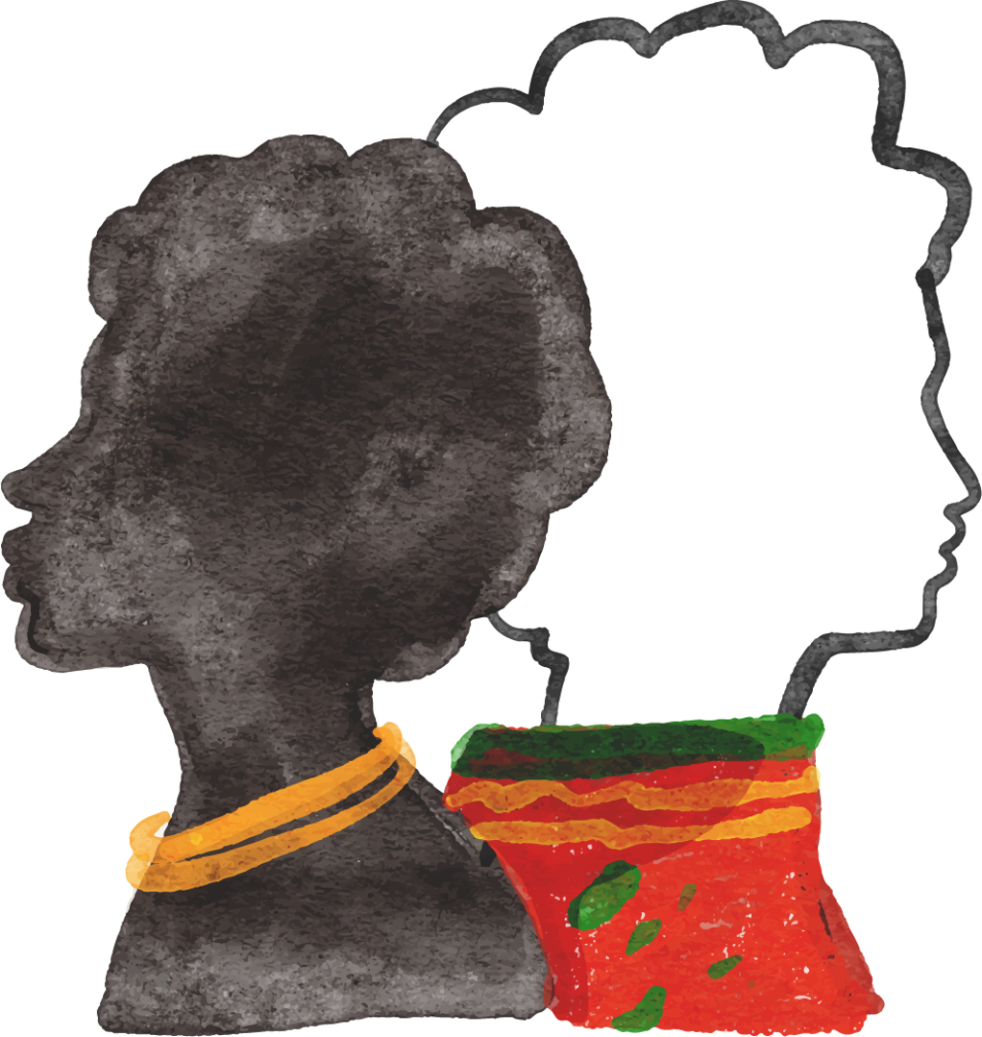
Emilie Davis
Free Black woman in Philadelphia, 22 years old in 1861
Daughter with siblings (at least two brothers)
Lived in Philly’s 7th Ward
She attended the Institute of Colored Youth/Lombard School
Went to 7th St. Presbyterian Church

Slide 9
Emilie’s agency as a free Black woman can be seen in her thoughts regarding:
Black Military Service
Social Life
Abolition

Slide 10

Emilie Davis Station Activity
For your station:
Read the Emilie Davis excerpts related to the category.
Selected primary sources that also relate.

Slide 11

Additional Primary Sources
Emilie Davis and Abolition
Poster
Douglass Speech
Emilie Davis and Black Military Service
Harper Speech
Emilie Davis and Social/Religious Life
Black Swan biography
Jonathan Gibbs’s speech
Station 1
Station 2
Station 3

Slide 12

Jigsaw Share/Rotate
Share some of your answers.
Come up with quotes or highlights you want to share with the whole group.
What did your station reveal about Emilie Davis?

Slide 13
Emilie Davis
What did you learn?

Slide 14
Final Discussion Questions
For those of you who keep a journal, what surprises you about Emilie’s diary entries? Any significant similarities or differences?
How do these documents combined and when put in comparison help us better understand Black life in Philadelphia during the Civil War?
How did Emilie Davis’s experiences in the audience impact her agency?
What other documents would you like to read or have access to about Emilie’s life? Why?
How did Black people’s beliefs in abolition likely differ from those of White people?
What are some overall contradictions revealed in these primary sources about Black people’s idea of the country and democracy versus those of White people?
Why is it important that we also learn from regular Black folk and not just Black icons?

Slide 15
Exit Assessment
How did Emilie Davis support the abolitionist movement? In your response, cite evidence from a primary source.
What was Emilie Davis’s life like in Philadelphia during the Civil War? In your response, cite evidence from a primary source.
Option 1
Option 2

Slide 16
Lesson Extension
Have students return to each primary-source speech as an audience member. Come up with a social media post as if you were in the audience hearing Douglass, Harper, or Gibbs speak. What would your post be about?

